Slide 1
priority queue
Programming Domain

Slide 2
What is a priority queue
A priority queue is an abstract data type that behaves similarly to the normal queue except that each element has some priority, i.e., the element with the highest priority would come first in a priority queue.
The priority of the elements in a priority queue will determine the order in which elements are removed from the priority queue.
Notes:
Insert a map of your country.

Slide 3
The priority queue supports only comparable elements, which means that the elements are either arranged in an ascending or descending order.
Notes:
Insert a map of your country.

Slide 4
For example, suppose we have some values like 1, 3, 4, 8, 14, 22 inserted in a priority queue with an ordering imposed on the values is from least to the greatest.
Therefore, the 1 number would be having the highest priority while 22 will be having the lowest priority.
Notes:
Insert a map of your country.

Slide 5
Characteristics of a Priority queue
Every element in a priority queue has some priority associated with it.
An element with the higher priority will be deleted before the deletion of the lesser priority.
If two elements in a priority queue have the same priority, they will be arranged using the FIFO principle.
Notes:
Insert a map of your country.

Slide 6
priority queue example
We have a priority queue that contains the following values:
1, 3, 4, 8, 14, 22
All the values are arranged in ascending order.
Now, lets will observe how the priority queue will look after performing the following operations:
Notes:
Insert a map of your country.

Slide 7
1, 3, 4, 8, 14, 22
poll(): This function will remove the highest priority element from the priority queue.
In the above priority queue, the '1' element has the highest priority, so it will be removed from the priority queue.
Notes:
Insert a map of your country.

Slide 8
1, 3, 4, 8, 14, 22
add(2): This function will insert '2' element in a priority queue. As 2 is the smallest element among all the numbers so it will obtain the highest priority.
Notes:
Insert a map of your country.

Slide 9
1, 3, 4, 8, 14, 22
poll(): It will remove '2' element from the priority queue as it has the highest priority queue.
Notes:
Insert a map of your country.

Slide 10
1, 3, 4, 8, 14, 22
add(5): It will insert 5 element after 4 as 5 is larger than 4 and lesser than 8, so it will obtain the third highest priority in a priority queue
Notes:
Insert a map of your country.

Slide 11
Types of Priority Queue
Ascending order priority queue
Descending order priority queue
Notes:
Insert a map of your country.

Slide 12
ascending order priority queue
In ascending order priority queue, a lower priority number is given as a higher priority in a priority.
For example, we take the numbers from 1 to 5 arranged in an ascending order like 1,2,3,4,5; therefore, the smallest number, i.e., 1 is given as the highest priority in a priority queue.
Notes:
Insert a map of your country.

Slide 13
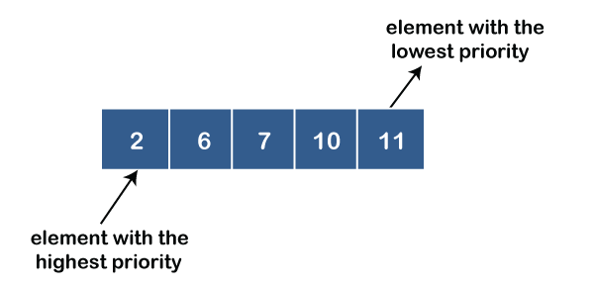
Notes:
Insert a map of your country.

Slide 14
Descending order priority queue
In descending order priority queue, a higher priority number is given as a higher priority in a priority.
For example, we take the numbers from 1 to 5 arranged in descending order like 5, 4, 3, 2, 1; therefore, the largest number, i.e., 5 is given as the highest priority in a priority queue.
Notes:
Insert a map of your country.

Slide 15
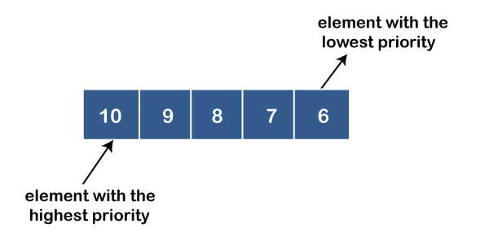
Notes:
Insert a map of your country.

Slide 16
Representation of priority queue
We will create the priority queue by using the list given below in which INFO list contains the data elements, PRN list contains the priority numbers of each data element available in the INFO list, and LINK basically contains the address of the next node
Notes:
Insert a map of your country.

Slide 17
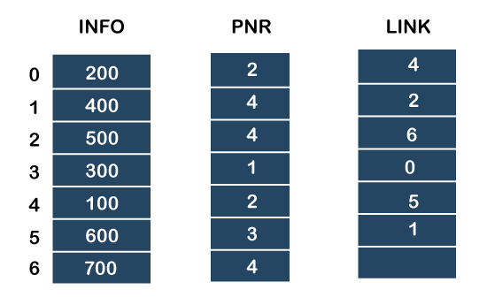
Notes:
Insert a map of your country.

Slide 18
In the case of priority queue, lower priority number is considered the higher priority, i.e., lower priority number = higher priority.
Step 1: In the list, lower priority number is 1, whose data value is 300, so it will be inserted in the list as shown in the below diagram:
Notes:
Insert a map of your country.

Slide 19
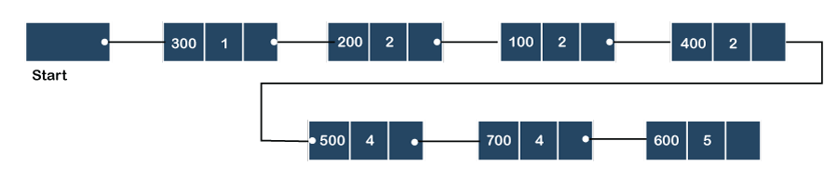
Notes:
Insert a map of your country.

Slide 20
Step 2: After inserting 300, priority number 2 is having a higher priority, and data values associated with this priority are 200 and 100.
So, this data will be inserted based on the FIFO principle; therefore 200 will be added first and then 100.
Notes:
Insert a map of your country.

Slide 21
Notes:
Insert a map of your country.

Slide 22
Step 3: After inserting the elements of priority 2, the next higher priority number is 4 and data elements associated with 4 priority numbers are 400, 500, 700. In this case, elements would be inserted based on the FIFO principle; therefore, 400 will be added first, then 500, and then 700.
Notes:
Insert a map of your country.

Slide 23
Notes:
Insert a map of your country.

Slide 24
Step 4: After inserting the elements of priority 4, the next higher priority number is 5, and the value associated with priority 5 is 600, so it will be inserted at the end of the queue.
Notes:
Insert a map of your country.

Slide 25
Notes:
Insert a map of your country.

Slide 26
Implementation of Priority Queue
The priority queue can be implemented in four ways that include arrays, linked list, heap data structure and binary search tree.
The heap data structure is the most efficient way of implementing the priority queue
Notes:
Insert a map of your country.

Slide 27
What is heap
ALREADY COVERED
Notes:
Insert a map of your country.

Slide 28
Priority Queue Operations
The common operations that we can perform on a priority queue are insertion, deletion and peek.
Let's see how we can maintain the heap data structure.
Notes:
Insert a map of your country.

Slide 29
Inserting the element in a priority queue (max heap)
If we insert an element in a priority queue, it will move to the empty slot by looking from top to bottom and left to right.
If the element is not in a correct place then it is compared with the parent node; if it is found out of order, elements are swapped. This process continues until the element is placed in a correct position.
Notes:
Insert a map of your country.

Slide 30
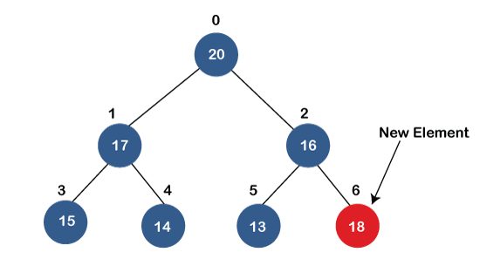
Notes:
Insert a map of your country.

Slide 31
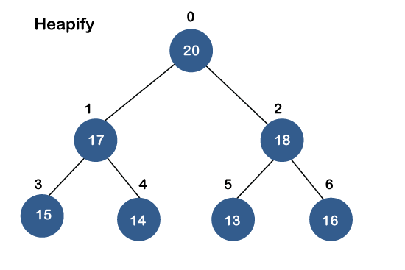
Notes:
Insert a map of your country.

Slide 32
Removing the minimum element from the priority queue
As we know that in a max heap, the maximum element is the root node.
When we remove the root node, it creates an empty slot.
The last inserted element will be added in this empty slot.
Then, this element is compared with the child nodes, i.e., left-child and right child, and swap with the smaller of the two.
It keeps moving down the tree until the heap property is restored.
Notes:
Insert a map of your country.

Slide 33
Applications of Priority queue
It is used in the Dijkstra's shortest path algorithm.
It is used in prim's algorithm
It is used in data compression techniques like Huffman code.
It is used in heap sort.
It is also used in operating system like priority scheduling, load balancing and interrupt handling
Notes:
Insert a map of your country.

